Slide 1
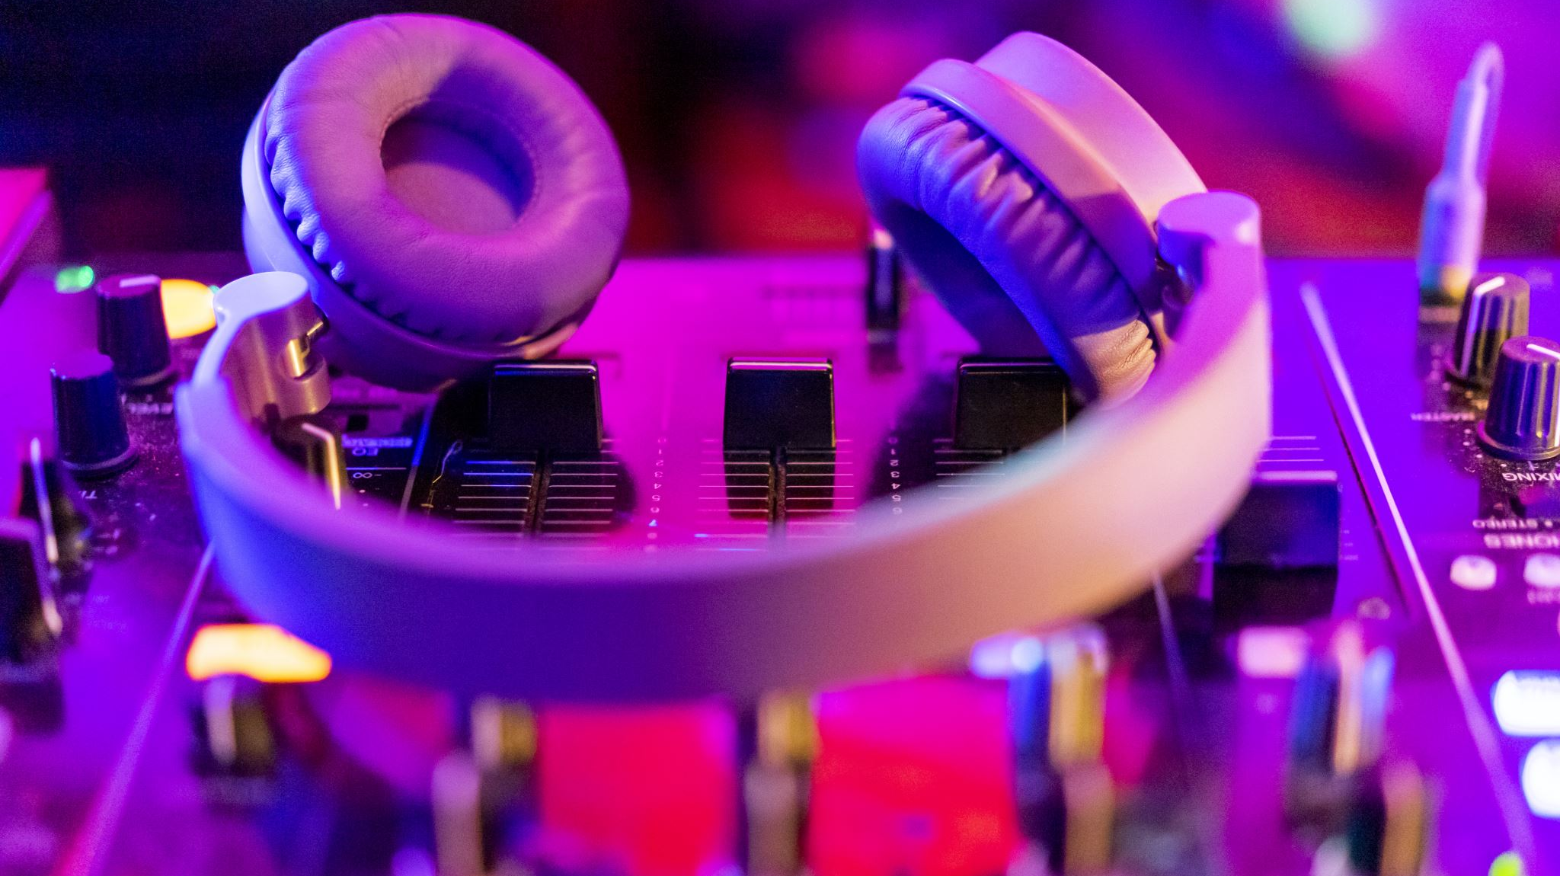
Intro to audio
Day 3
Introduction to DL in Social Sciences

Slide 2
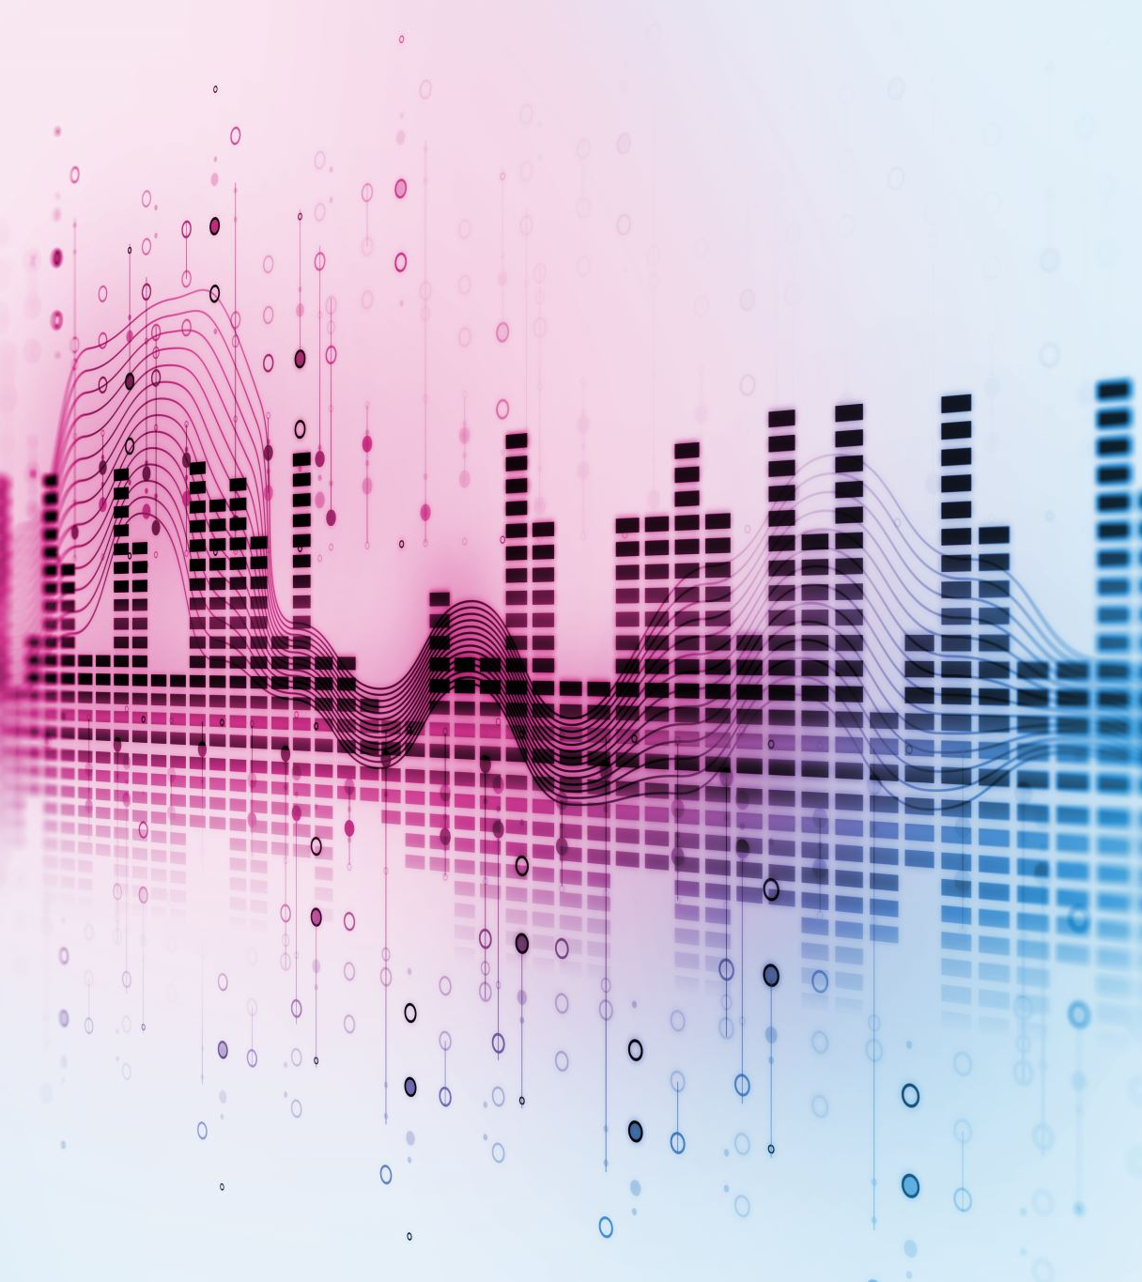
What we will cover
Working with audio data:
audio processing techniques and
data preparation
Audio tasks and applications
Audio transformer architectures
Main audio models

Slide 3
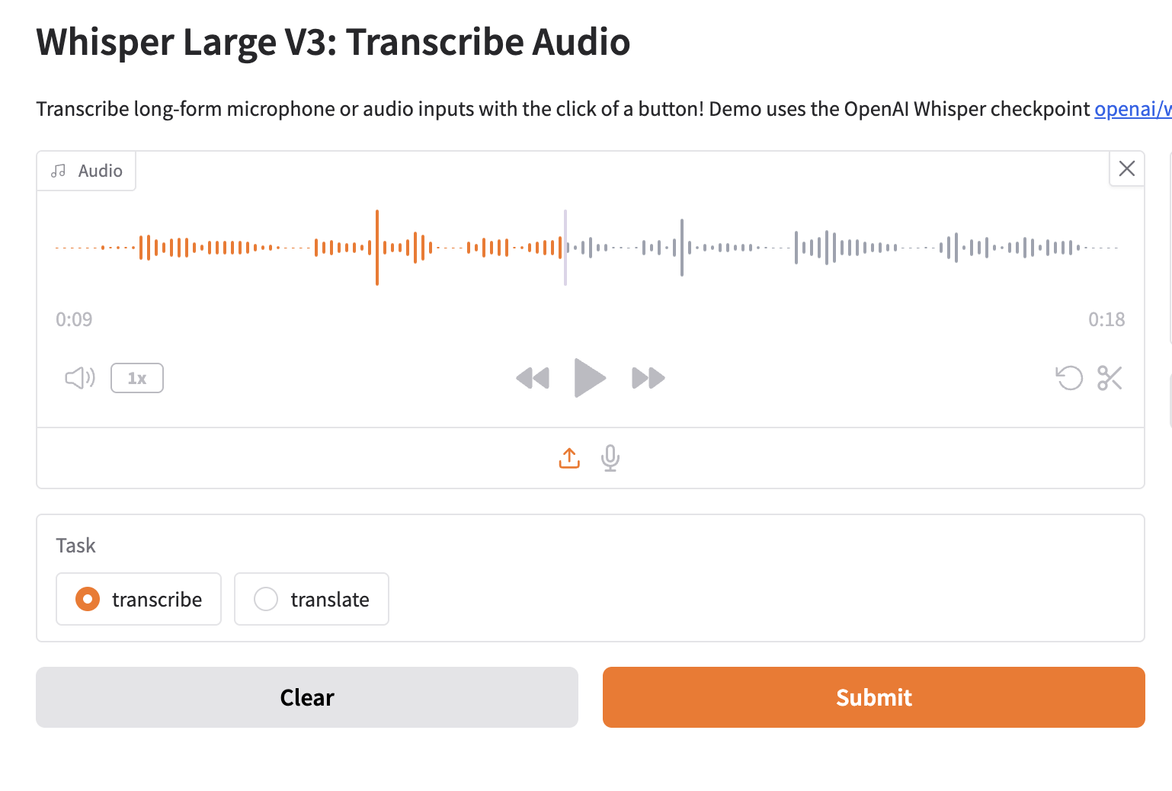
What is audio data
Natural sound = continuous signal (infinite values over time) that must be converted into discrete/digital form.
Common file formats:
.wav,
.flac,
.mp3 — differ mostly in compression and fidelity.
https://openai-whisper.hf.space/

Slide 4
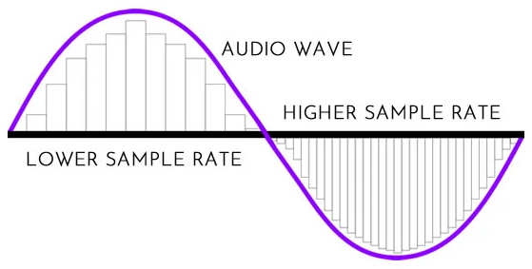
Sampling & Sampling Rate
Sampling = taking measurements of the continuous signal at fixed time intervals.
Sampling rate = number of samples per second (Hz).
Higher rate = higher highest frequency that can be captured.
Examples: CD-quality = 44,100 Hz; many speech models use 16,000 Hz.
Key constraint: need same sampling rate across dataset; mismatch causes problems.

Slide 5
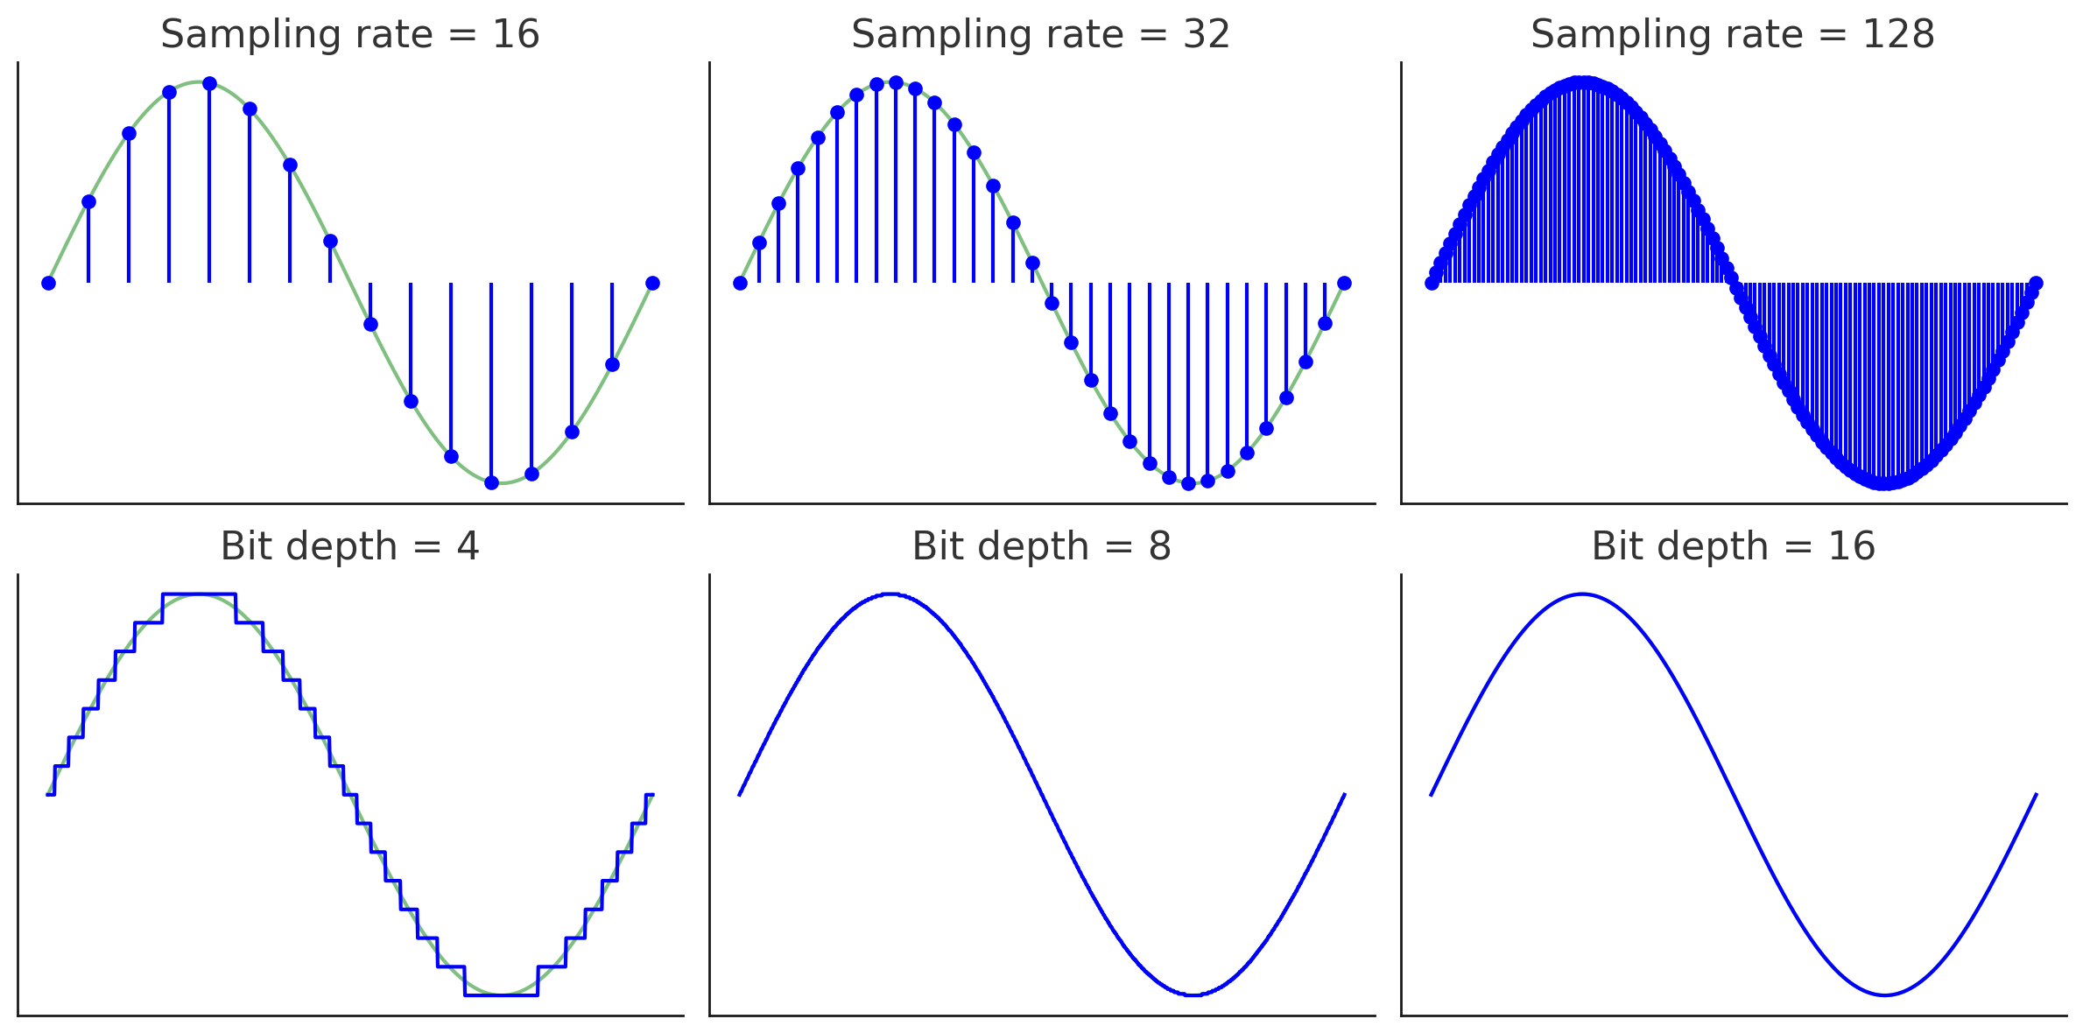
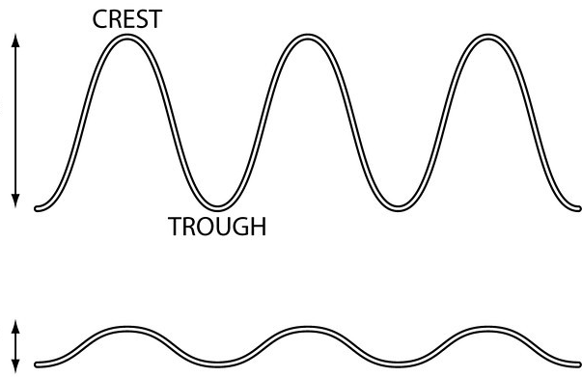
Amplitude & Bit Depth
Sampling rate = how often you measure the sound.
Bit depth = how finely you measure each point.
Amplitude = strength of sound waves; relates to loudness.
Bit depth = How many “steps” you have to record the loudness of each sample.
Determines dynamic range (quietest → loudest possible sounds) and noise floor.
Examples:
8-bit → 256 levels (grainy, noticeable noise).
16-bit → 65,536 levels (CD quality).
24-bit / 32-bit float → pro audio, high fidelity.

Slide 6
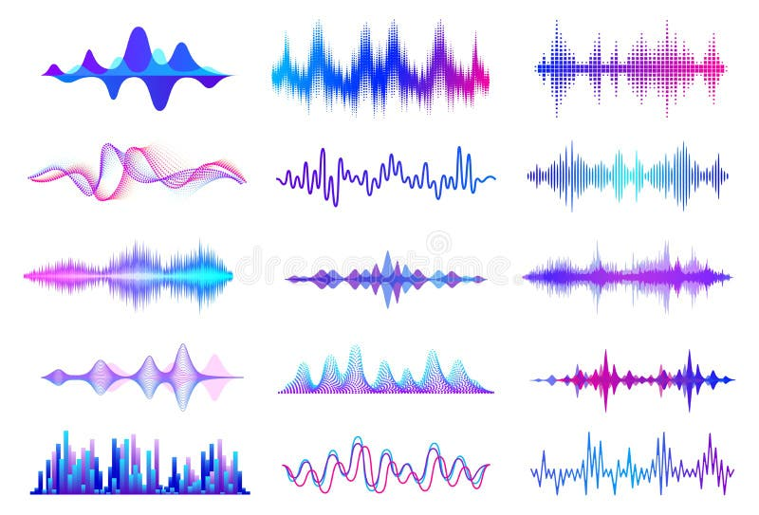
Waveform (Time-Domain Representation)
Graph of amplitude vs time.
Good for seeing timing, loudness, noise, irregularities.
Useful when verifying preprocessing (e.g. normalization, resampling)

Slide 7
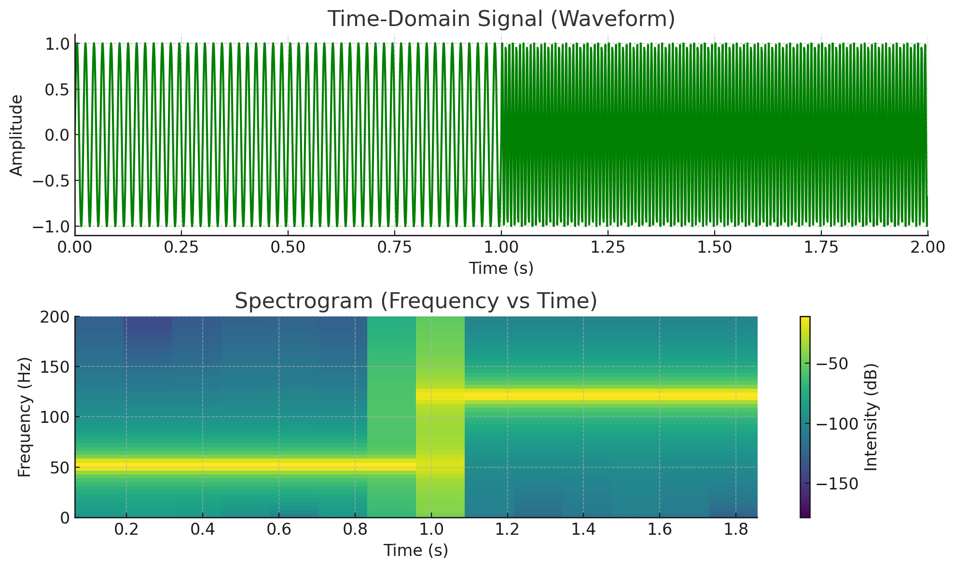
Frequency Spectrum
Shows which frequencies are present in a signal and their strengths.
Computed via Discrete Fourier Transform (DFT) / Fast Fourier Transform (FFT).
Amplitude spectrum (magnitude), sometimes converted to decibels.
Audio frequency spectrum spans the frequency range of 20 to 20,000 Hz, defined by the lowest and highest frequencies perceivable to a healthy human ear
Top (waveform): Time-domain view, but it looks busy and hides frequency changes.
Bottom (spectrogram): Frequency vs Time, with color = intensity.
From 0–1s → dominant band at 50 Hz.
From 1–2s → dominant band at 120 Hz.

Slide 8
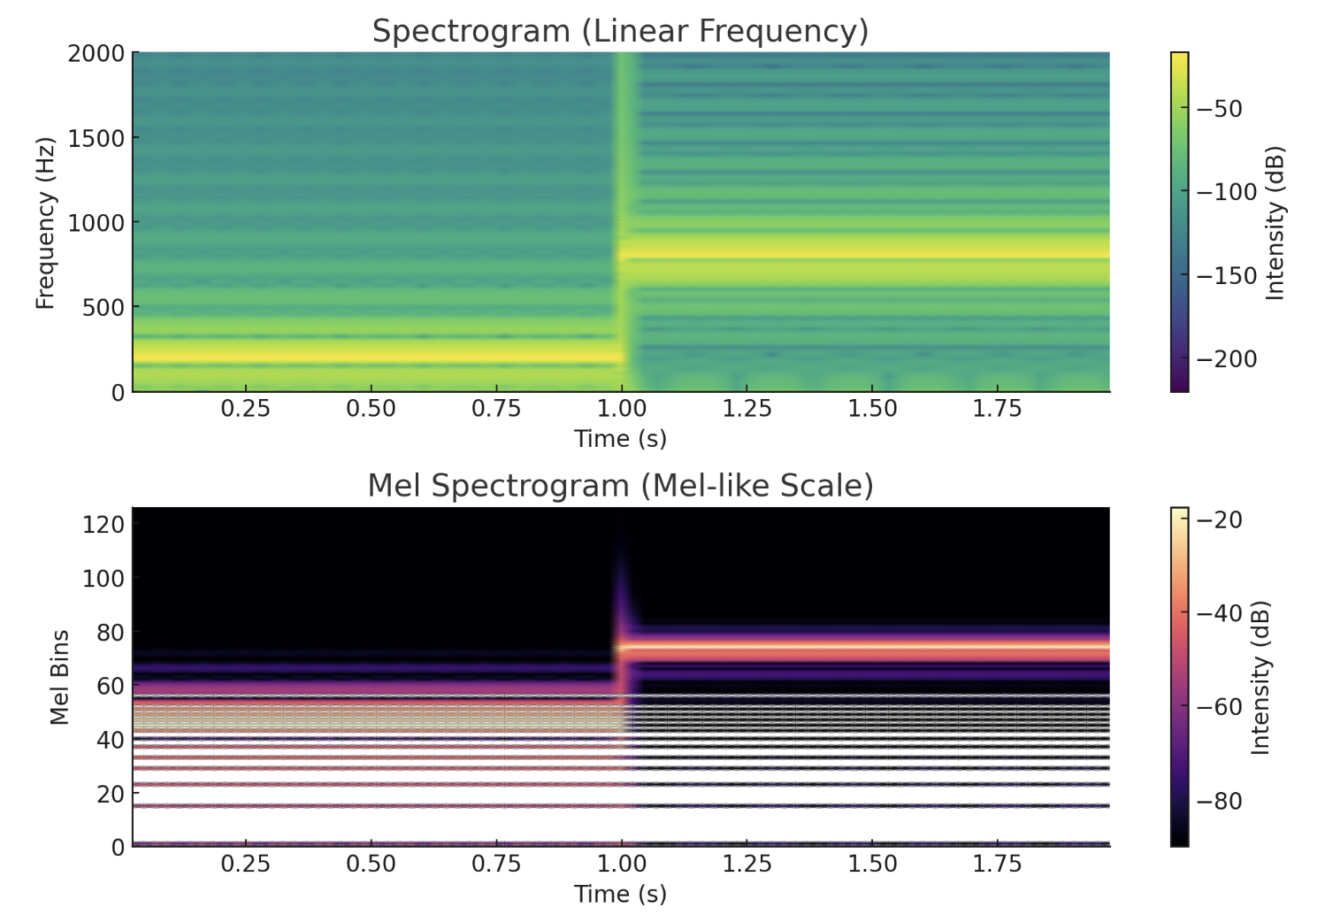
Spectrogram & Mel Spectrogram
Spectrogram: break signal into short time slices, compute spectrum per slice → stacked to see how frequencies change over time.
Mel Spectrogram: uses mel-scale (perceptual scale) on frequency axis (more aligned with human hearing). Includes filter banks; often log scale.
Widely used as input features in many ML tasks (speech recognition, speaker ID, music genre, etc.).
Сonverting mel spectrogram back to waveform is lossy / non-trivial; requires phase estimation (e.g. Griffin-Lim or neural vocoders).

Slide 9
Spectrogram & Mel Spectrogram
What it is: Slice audio into short windows, run FFT → shows all frequencies on a linear scale (0 Hz up to Nyquist).
Axis meaning:
X = time
Y = frequency (linear: equal spacing, e.g. 100 Hz, 200 Hz, 300 Hz …)
Color = energy (dB)
Good for: music analysis, technical signals, general sound engineering.
Limitation: humans don’t hear frequencies linearly → we perceive pitch changes differently at low vs high ranges.
What it is: Same as spectrogram, but frequency axis is warped to the Mel scale (psychoacoustic scale approximating human hearing).
Axis meaning:
X = time
Y = mel bins (not equally spaced Hz; compressed at high end, stretched at low end).
Color = energy (dB)
Good for: speech recognition, voice tasks, most ML audio models.
Advantage: emphasizes perceptually important low–mid frequencies, reduces irrelevant high-frequency detail → more compact & human-like features.
Spectrogram = “raw ruler” measuring all frequencies equally.
Mel spectrogram = “human ruler” — re-scales frequencies to how our ears perceive them.

Slide 10
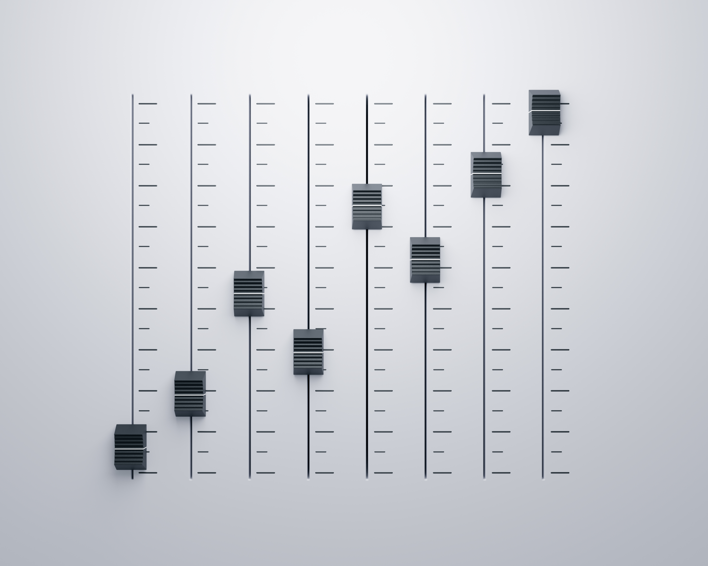
Data preprocessing for Transformers
Resample to target sampling rate (e.g. 16 kHz) to match model requirements.
Pad or truncate to a fixed length (model-specific, e.g. 30s for Whisper).
Normalize amplitude (convert to floating point values, typically in range –1.0 to +1.0).
Convert to features:
Waveform (raw samples) for some models.
Spectrogram / log-mel spectrogram for most speech/audio models.
Batching: pad/truncate consistently across the batch.
Attention mask (most models need it; Whisper doesn’t).

Slide 11
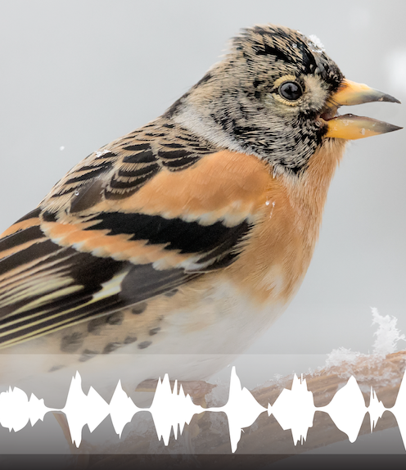
Audio tasks
Audio classification → categorize clips (e.g., barking vs meowing, music genres).
Automatic speech recognition (ASR) → transcribe speech into text (e.g., “How are you doing today?”).
Speaker diarization → detect who is speaking and when (e.g., Alice vs Bob in a conversation).
Text-to-speech (TTS) → convert text into natural-sounding audio (e.g., audiobooks, accessibility, game voices).

Slide 12
Challenges & Considerations
High compute cost
Self-attention scales quadratically with sequence length.
Raw audio has very long sequences (e.g., 16 kHz = 16,000 samples per second).
Workarounds: spectrogram features, patching, efficient attention variants.
Large labeled data needs
Variability of real audio
Background noise, overlapping speech, channel effects.
Different sampling rates
Speaker variation (gender, accent, pitch, tempo).
Requires normalization, augmentation, or domain adaptation.
Latency & real-time use
Solutions: chunked processing, low-latency architectures, quantization.
Evaluation challenges
Metrics differ per task: WER (ASR), accuracy (classification), MOS (TTS).
Human perception doesn’t always align with automatic metrics

Slide 13
Evolution of Audio in Machine Learning
CNNs & RNNs (Early Deep Learning)
Approach: Feed spectrograms to CNNs (like images) or raw waveforms to CNN/RNN hybrids.
Strengths: Learn features automatically, better performance than hand-crafted.
Limitations: Struggled with long-range dependencies; RNNs hard to scale.
Seq2Seq Transformers (Unified Multitask Models)
Approach: Encoder-decoder architectures for flexible input → output mapping.
Models: Whisper (speech → text/translation), SpeechT5 (speech ↔ text ↔ speech).
Strengths: Robust multilingual, multitask, long-context models.
Limitations: High compute cost, slower autoregressive decoding.
Encoder-only Transformers + CTC (Self-Supervised Era)
Breakthrough: Treat audio as a long sequence; use transformer encoders (self-attention).
Models: Wav2Vec2, HuBERT, M-CTC-T.
Training: Self-supervised (predict masked spans, contrastive objectives).
Use cases: Automatic Speech Recognition (ASR), speaker ID, emotion recognition.
Strengths: Massive pretraining on unlabeled audio → less labeled data needed.
Multimodal Audio Models (Current Frontier)
Approach: Jointly process audio + text + vision.
Models: CLAP (Contrastive Language–Audio Pretraining), AudioLM, Gemini-style multimodal LLMs.
Capabilities: Zero-shot classification, audio captioning, text-to-speech, music generation.
Vision: General foundation models that handle audio as one modality among many.

Slide 14
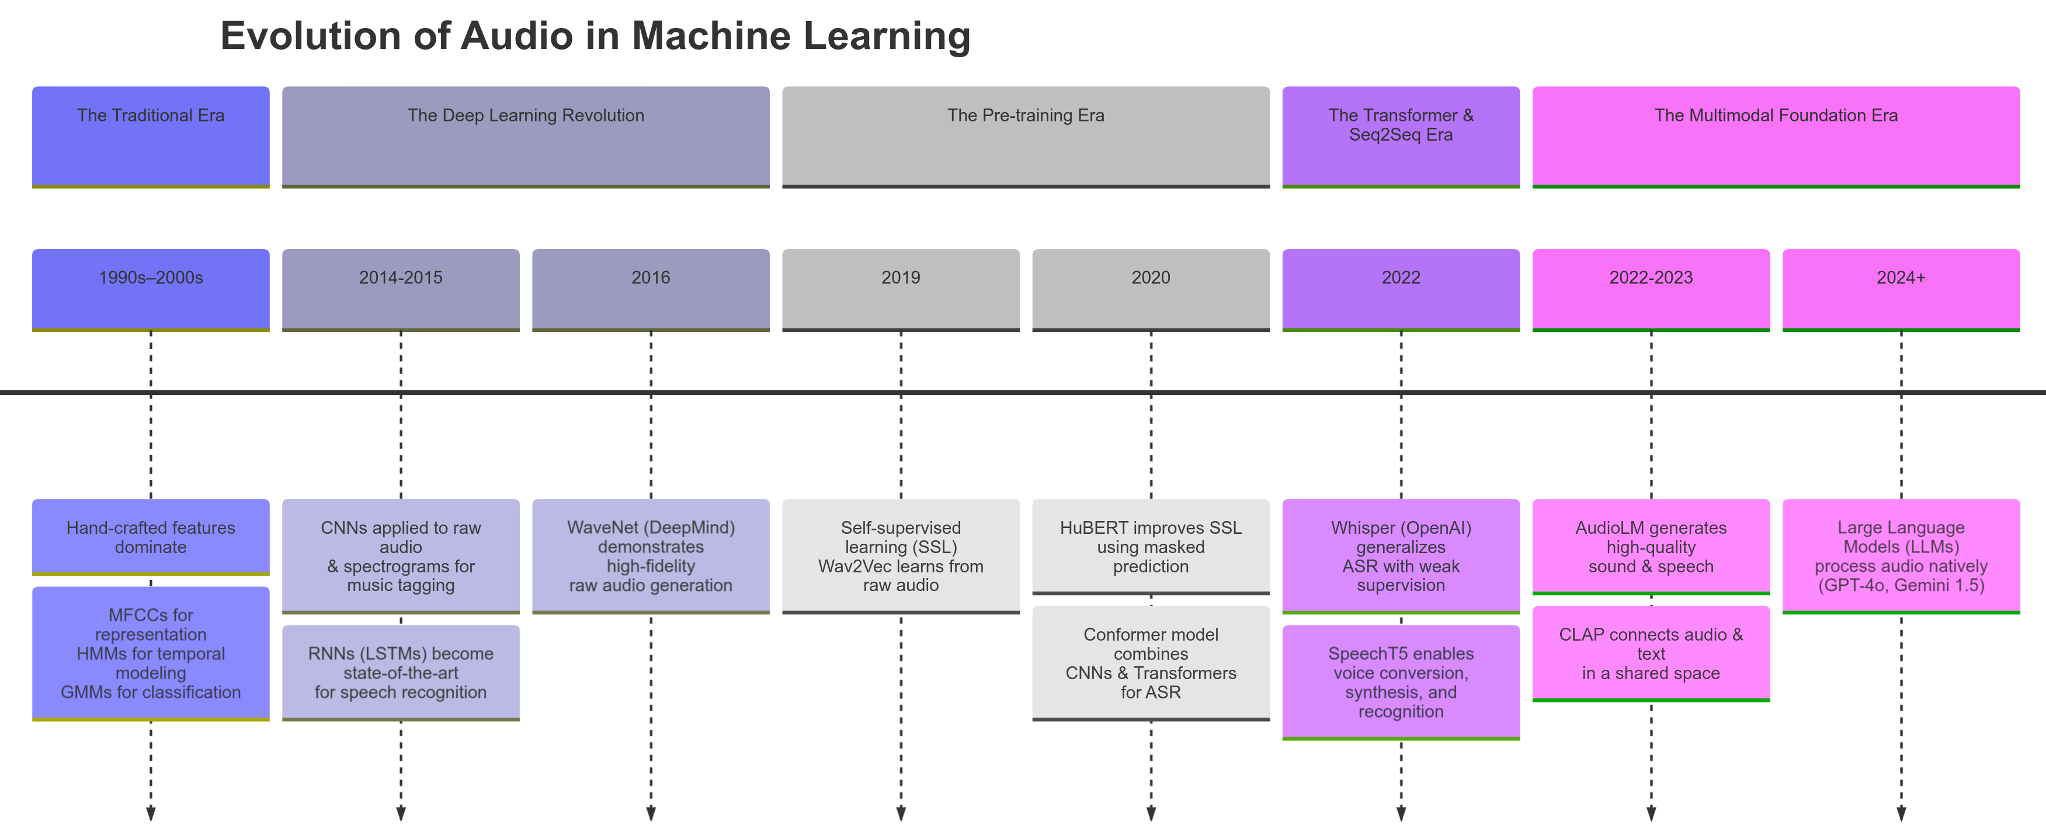
Notes:
CNNs & RNNs (Early Deep Learning)
Approach: Feed spectrograms to CNNs (like images) or raw waveforms to CNN/RNN hybrids.
Models: DeepSpeech (RNN-based), CRNNs for sound events.
Strengths: Learn features automatically, better performance than hand-crafted.
Limitations: Struggled with long-range dependencies; RNNs hard to scale.
Encoder-only Transformers + CTC (Self-Supervised Era)
Breakthrough: Treat audio as a long sequence; use transformer encoders (self-attention).
Models: Wav2Vec2, HuBERT, M-CTC-T.
Training: Self-supervised (predict masked spans, contrastive objectives).
Use cases: Automatic Speech Recognition (ASR), speaker ID, emotion recognition.
Strengths: Massive pretraining on unlabeled audio → less labeled data needed.
Seq2Seq Transformers (Unified Multitask Models)
Approach: Encoder-decoder architectures for flexible input → output mapping.
Models: Whisper (speech → text/translation), SpeechT5 (speech ↔ text ↔ speech).
Strengths: Robust multilingual, multitask, long-context models.
Limitations: High compute cost, slower autoregressive decoding.
Multimodal Audio Models (Current Frontier)
Approach: Jointly process audio + text + vision.
Models: CLAP (Contrastive Language–Audio Pretraining), AudioLM, Gemini-style multimodal LLMs.
Capabilities: Zero-shot classification, audio captioning, text-to-speech, music generation.
Vision: General foundation models that handle audio as one modality among many.

Slide 15

Transformers vs Audio transformers
Input is continuous waveform, not discrete tokens.
Directly passing raw samples = impractical (too long: 16k samples/sec).
So → audio must be converted into shorter sequences before entering the transformer:
Spectrogram patches (like image patches).
Feature frames (e.g. log-mel features every 20–25 ms).
These frames/patches are then treated as “tokens” for the transformer.
Original design: text (NLP).
Input = sequence of tokens (words, subwords, characters).
Embedding layer maps tokens → vectors.
Transformer uses self-attention to model relationships between all tokens.
Output: hidden states → classification, generation, etc.

Slide 16
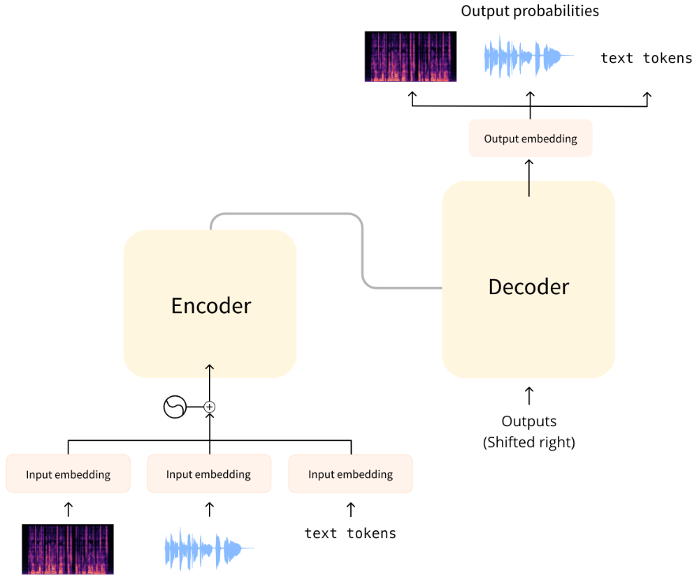
Audio transformer

Slide 17
Audio transformers
Data preprocessing: feature extraction (turning waveform into “tokens”)
Sequence Length Reduction
Task-Specific Heads
Classification head → one vector → softmax over classes (sound classification).
CTC head → per-frame logits → collapse with blank/deduplication (ASR).
Seq2Seq decoder → autoregressive text tokens (ASR, translation) or spectrogram slices (TTS).
Pretraining Strategies: Audio models rarely trained from scratch → use self-supervised pretraining
Handling Noise & Variability: Augmentations, normalization, robust pretraining across varied domains.

Slide 18
Models & Examples
Whisper:
Multilingual ASR /
Translation /
Diarization
Wav2Vec / HuBERT:
Self-supervised speech representations
Audio Spectrogram Transformer:
Spectrogram-based input

Slide 19
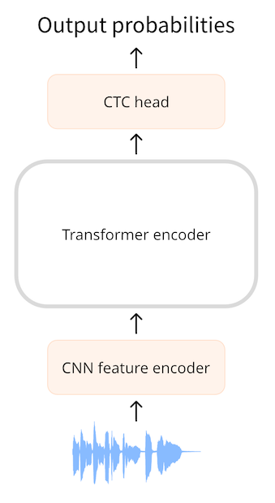
What is CTC?
CTC = Connectionist Temporal Classification
Map a long sequence of input frames (audio) → a shorter sequence of labels (usually characters or phonemes) without knowing the alignment.
Used with encoder-only transformer models (no decoder)
Common models: Wav2Vec2, HuBERT, M-CTC-T

Slide 20
Why CTC?
Example:
Input: audio waveform → turned into ~1000 frames (20ms each).
Output: transcript = "hello" (5 characters).
Challenge: We don’t know which frame corresponds to “h,” “e,” etc.
CTC’s job: Train the model so it can:
Predict a character (or blank) at each frame.
Collapse repeats + blanks.
Produce "hello" at the end.
In speech, audio length ≠ transcript length.
We don’t know which part of the audio corresponds to each letter/word.
We need a way to align variable-length audio frames → shorter text sequence.

Slide 21

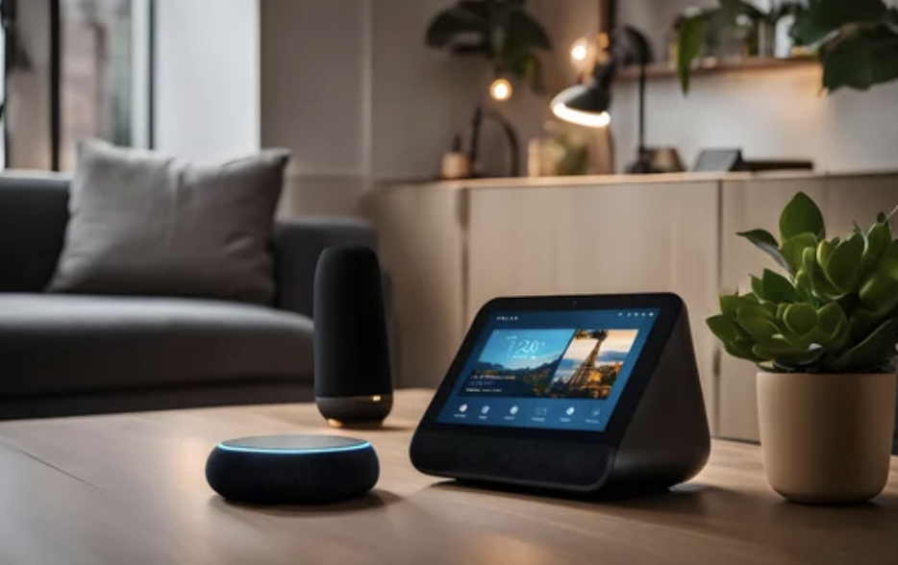
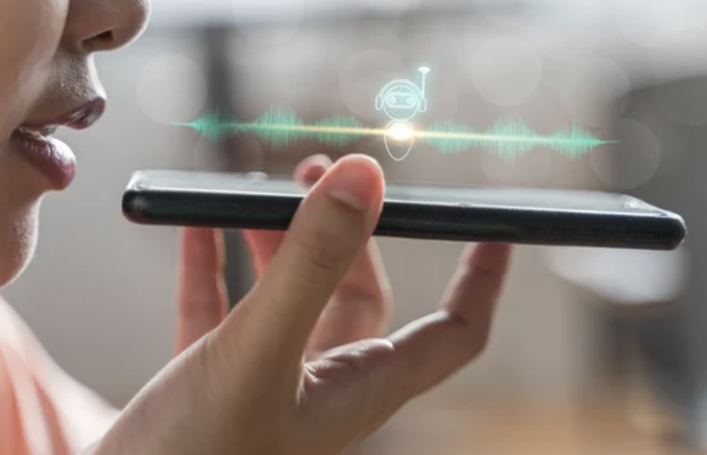
Why/When CTC is Useful
Automatic speech recognition (ASR) when alignment is unknown
Handles monotonic order: speech → transcript
Best with small vocabularies (characters, phonemes)

Slide 22
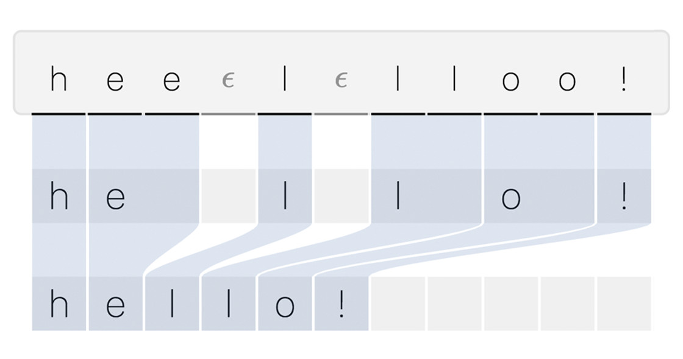
How CTC works?
Model predicts one label per frame (e.g. every 20ms),
But words are much shorter than frames → so we’ll see repeats and empty gaps.
To get a clean transcript, we need a rule to shrink the long framewise sequence.

Slide 23

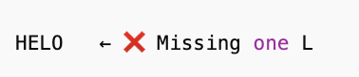



Key problem CCT solves: The Blank Token + Deduplication
- You want to transcribe HELLO. The sound “LL” is long, so the model sees multiple frames of “L”
- Collapse duplicates = merge consecutive repeats
The model can insert blanks between repeated letters
Step 1: Collapse duplicates (merge consecutive same letters)
Step 2: Remove blanks (_ = silence / gap):
Model output (per frame)

Slide 24
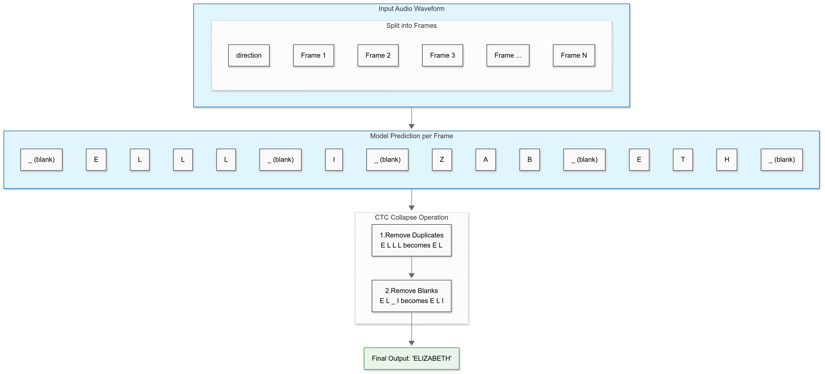
CTC Training: When to Insert Blanks and When Not
Audio is split into frames (~20ms each).
The model predicts a label (character or blank) for every frame.
CTC loss considers all possible alignments of “ELIZABETH” to the frame sequence.
e.g. one alignment may stretch L over 3 frames.
another may stretch it over 5 frames.
As long as, after “collapse duplicates + remove blanks,” the output is ELIZABETH, it counts as correct.
Loss = -log(probability of correct transcript)
👉 This way, the model learns from data how long to hold “L” in typical speech.

Slide 25

CTC Benefits:
Simpler & Faster
Encoder-only → less compute, easier to train/infer.
Good for real-time or resource-constrained settings.
Handles unknown timing automatically
Speech is continuous — we don’t know exactly when “H” in “HELLO” starts or ends.
CTC doesn’t need that alignment info.
It explores all possible frame-to-text alignments internally.
Perfect for ASR (Automatic Speech Recognition)
Especially for transcribing speech (not translating, not generating new text).
Example: call center logs, subtitles, voice assistants.

Slide 26

CTC Limitations:
Outputs at character level → may have spelling errors.
Usually needs an external language model to fix grammar/fluency.
Less flexible than seq2seq (no translation, summarization).

Slide 27
Different CTC-based Models
Aspect | Wav2Vec2 | HuBERT | M-CTC-T
Input | Raw waveform (downsampled) | Raw waveform | Spectrograms / features
Architecture | CNN feature extractor + Transformer encoder | Transformer encoder (similar to Wav2Vec2) | Encoder-only Transformer with CTC head
Pretraining | Contrastive predictive coding → predict masked spans | Predict masked pseudo-labels (clustering + BERT-style) | Supervised multilingual training with CTC
Vocabulary | Usually characters (flexible, task-dependent) | Pseudo-labels → phoneme-like units | Multilingual subword vocab
Strengths | Strong low-level acoustic features; easy fine-tuning for ASR | Richer high-level speech units; good for phoneme/word tasks | Simple, fast, multilingual ASR out-of-the-box
Limitations | Needs large data + negatives for contrastive training | Relies on clustering quality; more complex training | Needs labeled data; less general outside ASR

Slide 28

CTC
CTC = maps audio to text without needing alignment info
Efficient for encoder-only transformers
Trade-offs vs seq2seq: less fluent but simpler & faster
Popular models: Wav2Vec2, HuBERT, M-CTC-T

Slide 29
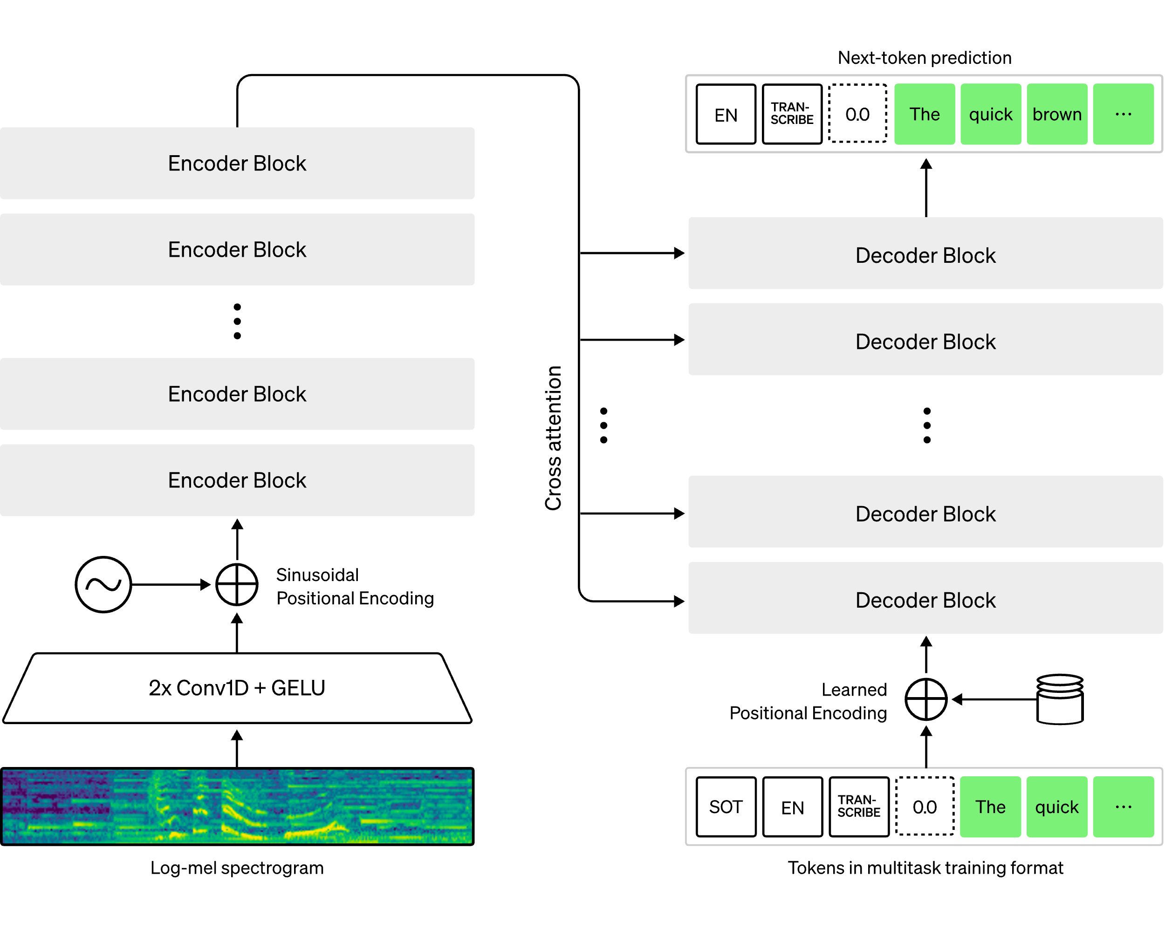
Seq2Seq architectures
Encoder (e.g. CTC) + decoder model: → Seq2Seq
Maps a sequence of one kind of data to a sequence of another kind of data.
Input & output lengths can differ (unlike CTC)
Used for tasks like ASR, translation, summarization

Slide 30
Aspect | CTC (Encoder) | Seq2Seq (Encoder–Decoder)
Architecture | Encoder-only (e.g. Wav2Vec2, HuBERT) | Encoder + autoregressive decoder (e.g. Whisper, SpeechT5)
Alignment | Implicitly handled via blanks & duplicates | Learned explicitly via attention mechanism
Decoding | Frame-level predictions → collapse duplicates + remove blanks | Token-by-token generation with cross-attention
Speed | Faster (parallelizable, no decoder loop) | Slower (autoregressive decoding)
Output Quality | Good for character/phoneme-level transcriptions; may need external LM for fluency | Higher fluency & flexibility (better language modeling built-in)
Tasks | Automatic Speech Recognition (ASR), phoneme recognition | ASR, speech translation, summarization, text-to-speech
Strengths | Simpler, efficient, strong for pure transcription | Flexible, multilingual, handles complex mappings
Limitations | Less fluent text, limited to monotonic mappings | Heavier compute cost, higher latency

Slide 31
Seq2Seq ASR Pipeline (e.g. Whisper)
Encoder
Input = log-mel spectrogram (or raw waveform in some designs).
Produces hidden states that capture the “meaning” of the speech.
Decoder
Acts as a language model.
Learns both alignment + fluency end-to-end.
More powerful than CTC (even with external LM).
Uses cross-attention to attend to encoder’s hidden states.
Predicts text autoregressively:
Start with a special start token (SOT).
At each step: feed back previous outputs → predict next token.
Stop when end token or max length is reached.
Vocabulary is large: outputs words or subwords, not just characters

Slide 32
Cross-attention vs attention
Aspect | Self-Attention | Cross-Attention
Where it’s used | Encoder & Decoder (internal layers) | Decoder (Seq2Seq models)
What attends to what | Tokens attend to other tokens in the same sequence | Decoder tokens attend to encoder outputs
Purpose | Capture relationships within one sequence (context) | Connect two sequences (input → output)
Example (ASR) | Spectrogram frames relate to each other; text tokens relate to each other | Text tokens (decoder) attend to encoded speech features (encoder)
Analogy | Students in a classroom learning from each other | Students looking at teacher’s notes while writing

Slide 33
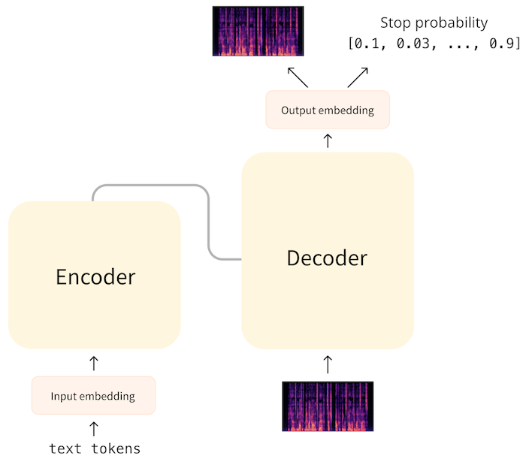
Seq2Seq for Text-to-Speech (TTS)
Architecture
Encoder: processes text tokens → hidden states.
Decoder: uses cross-attention to hidden states → predicts spectrogram slices (one at a time).
Decoding Process
Start with a dummy spectrogram slice of all zeros (like “start token”).
Iteratively predict the next spectrogram timestep.
Stop when decoder predicts “end” probability > threshold (e.g. 0.5).
Post-processing
Post-net: convolutional layers refine predicted spectrogram.
Vocoder: converts spectrogram → audio waveform (trained separately).

Slide 34
Losses, Decoding & Metrics: ASR
Loss function:
Cross-entropy → compares predicted token distribution vs correct text token.
Example: target = "hello", model predicts "hallo" → penalty for a instead of e.
Decoding:
Beam search improves over greedy decoding by exploring multiple candidate sequences.
Example: input audio "I scream" — greedy might predict "ice cream" → beam search can disambiguate.
Evaluation metric:
WER (Word Error Rate) = (Substitutions + Insertions + Deletions) ÷ Total Words.
Example:
Reference: "the cat sat"
Prediction: "the hat"
Errors = 1 substitution (cat→hat), 1 deletion (sat missing`).
ASR → classification task (choose correct tokens).
ASR = objective string matching (WER)

Slide 35
Losses, Decoding & Metrics: TTS
Loss function:
L1 (absolute error) or MSE (squared error) between predicted vs target spectrogram.
Example: predicted spectrogram energy at frequency bin = 0.8, target = 1.0 → error = 0.2 (L1).
Decoding:
Iteratively generate spectrogram slices until stop condition.
No beam search needed for spectrogram regression (but used in vocoder models sometimes).
Evaluation metric:
MOS (Mean Opinion Score) → human listeners rate quality 1–5.
Example:
"The weather is sunny today."
Listener ratings: 5, 4, 4, 3, 5 → MOS = 4.2.
Captures naturalness/prosody, not just accuracy.
TTS → regression task (predict acoustic features)
TTS = subjective human quality judgment (MOS).

Slide 36
Audio architectures
CTC
CTC = maps audio to text without needing alignment info
Efficient for encoder-only transformers
Trade-offs vs seq2seq: less fluent but simpler & faster
Popular models: Wav2Vec2, HuBERT, M-CTC-T
Seq2Seq
Maps audio to text (or text to spectrogram) using encoder + decoder
Powerful for ASR, translation, and TTS (handles variable input/output lengths)
End-to-end training with cross-attention and autoregressive decoding
Trade-offs vs CTC: more fluent & flexible, but slower and heavier compute
Popular models: Whisper, SpeechT5, mBART-style speech models

Slide 37




What is Audio Classification?
Predict a class label for an input audio clip
Single label per clip, or labels per time-frame
Examples: bird song detection, sound events, intent categories

Slide 38
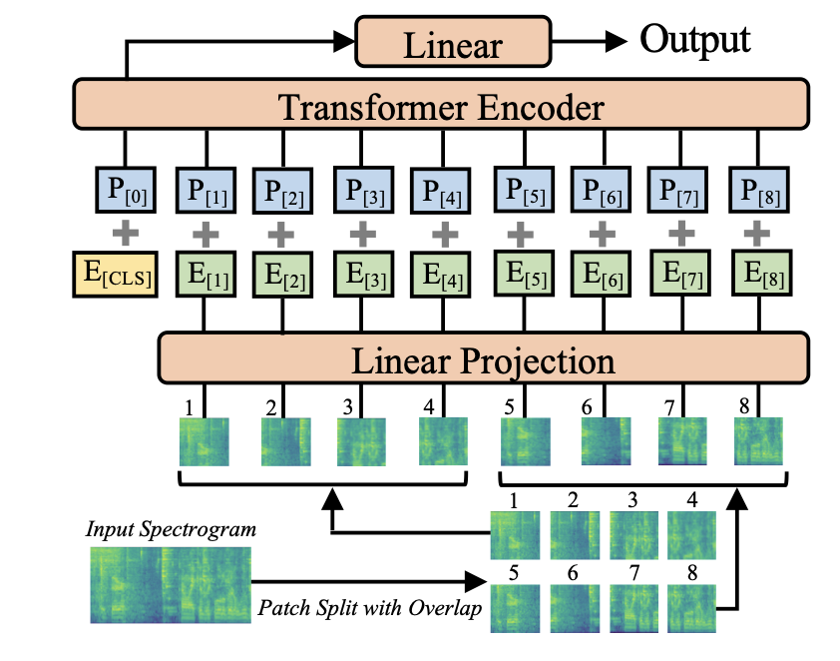
Spectrogram-based Classification
Spectrograms treated like images (freq vs time)
Models: ConvNets (ResNet, ConvNeXt), Vision Transformers (ViT)
Example: AST splits spectrogram into patches → transformer encoder → classifier
Note: spectrogram shifts ≠ image shifts (frequency meaning differs)
Notes:
Treat audio spectrograms like images for classification.
Spectrogram = 2D tensor (frequency × time).
Can feed into CNNs (e.g. ResNet) → good results.
Or into Vision Transformers (ViT) → better global context capture.
Audio Spectrogram Transformer (AST):
Splits spectrogram into 16×16 overlapping patches.
Projects patches → embeddings → transformer encoder.
Encoder outputs hidden states per patch.
Final classification layer + sigmoid → probabilities.

Slide 39

Using Transformer Encoders Directly
Any transformer can be a classifier
Audio encoders (e.g. Wav2Vec2) + classification head
Loss: cross-entropy (not CTC)
Modes:
– Sequence classification: one prediction per clip
– Frame classification: one prediction per time step

Slide 40

Architecture Choices & Trade-offs
Encoder-only models simpler/faster than seq2seq
Spectrograms reduce sequence length but lose detail
Frame vs sequence classification: temporal resolution vs global label
Small vs large models → speed & memory trade-offs

Slide 41

Zero-Shot Classification & Label Sets
Uses models like CLAP (Contrastive Language–Audio Pretraining).
Audio input and text labels (e.g. "dog barking", "car horn") are mapped into the same embedding space.
Model computes similarity scores between audio and each label description.
Examples
Input: audio clip of a baby crying.
Labels: ["baby crying", "dog barking", "car horn"].
Model: highest similarity score for "baby crying" → correct classification.

Slide 42
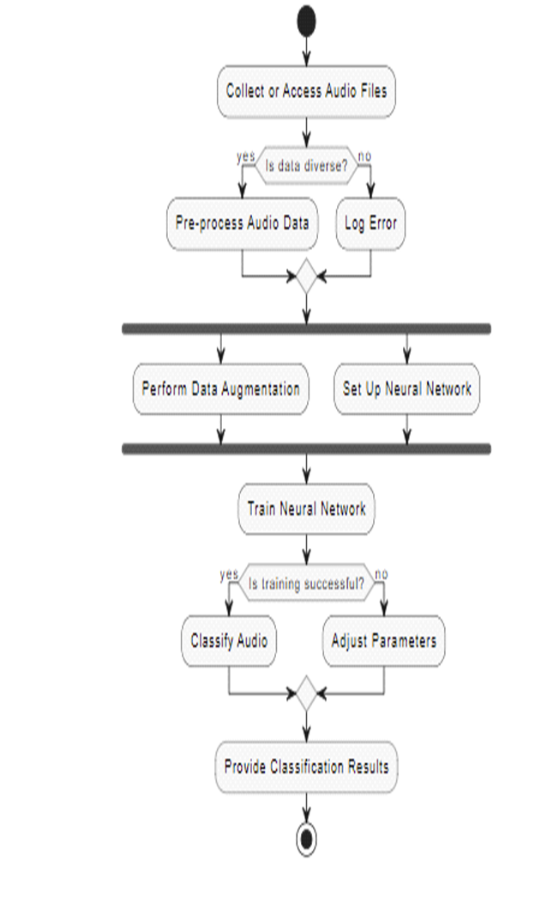
Zero-Shot Classification & Label Sets
How it works
Audio → audio encoder → embedding.
Label text → text encoder → embedding.
Similarity (cosine similarity) tells how well the audio matches the label.

Slide 43
Zero-Shot Classification
Advantages
No retraining needed for new tasks.
Can classify with any text labels, even ones not seen during training.
Great for broad sound event detection or quick prototyping.
Limitations
Works best when labels overlap with training concepts.
Mismatched or abstract labels (e.g. "serene mood") may not transfer well.
Accuracy lower than supervised models trained directly on the target dataset.

Slide 44
Common Models & Datasets
AST (Audio Spectrogram Transformer)
Wav2Vec2ForSequenceClassification
Wav2Vec2ForAudioFrameClassification
Datasets: Speech Commands, MINDS-14
Many pre-trained classification models on Hugging Face Hub

Slide 45
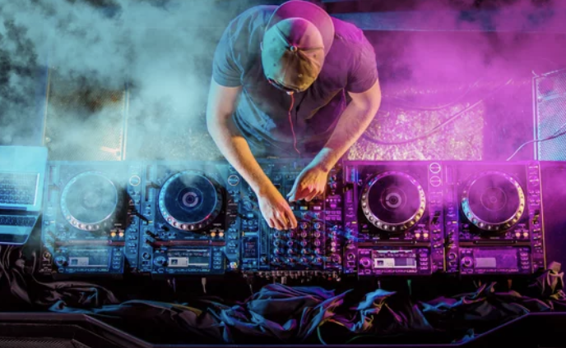
Practice

